Slide 1
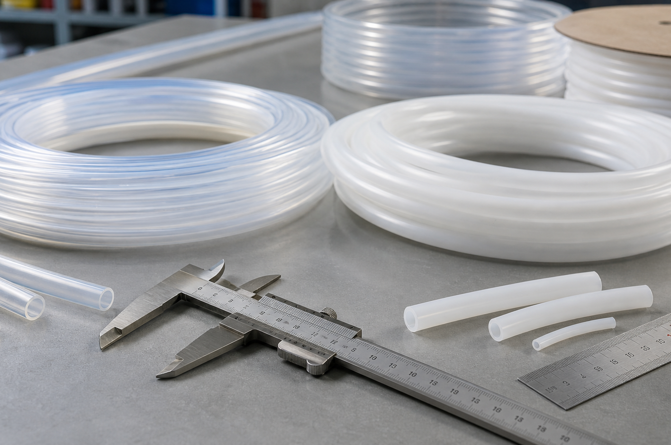
RFQ-ready catalog
Pure-Flon Fluoropolymer Tubing Catalog
RFQ-ready technical catalog for PTFE, PFA, FEP, flexible hose, custom-engineered connectors, metric and inch tubing references.
Technical specification tables are reorganized into a Pure-Flon buyer review path. Company introduction pages and supplier contact details are excluded.
Review tubing families, dimensions, pressure references, and system parts in one path.
Release 2026-06-04
Pure-Flon Fluoropolymer Tubing Catalog - RFQ reference, 2026-06-04
1

Slide 2
Buyer review path
Review tubing families, dimensions, pressure references, and system parts in one path.
RFQ-ready technical catalog for PTFE, PFA, FEP, flexible hose, custom-engineered connectors, metric and inch tubing references.
Buyer action
What to prepare
Pure-Flon review output
Shortlist material
Media, temperature, pressure, transparency, static control, and clean-handling needs.
Priority review path across PTFE, PFA, FEP, hose, or custom connectors.
Confirm dimensions
ID, OD, wall, tolerance, length, bend radius, and quantity.
Metric or inch sizing review plus manufacturing feasibility notes.
Request quote
Application environment, target lead time, destination country, certificate and packaging needs.
RFQ response path through pure-flon.com/quote.
Send the RFQ through pure-flon.com/quote and include the checklist details above.
Pure-Flon Fluoropolymer Tubing Catalog - RFQ reference, 2026-06-04
2

Slide 3
Material family matrix
Material family matrix
Family
Best-fit sourcing signal
Reference temperature
Buyer note
PTFE Tubing
Chemical resistance, heat resistance, low friction, and insulation.
65 deg C - 260 deg C
Use when durability and broad compatibility matter more than visual flow inspection.
PFA Tubing
High-purity chemical routing with visible clean flow.
65 deg C - 260 deg C
Start here when transparency and high-temperature stability both matter.
FEP Tubing
Transparent, non-stick routing in a moderate temperature window.
65 deg C - 205 deg C
A practical transparent option when PFA's upper heat range is not required.
Flexible Hose
Bend, pressure, assembly, and connection constraints.
Application-dependent
Send routing geometry and connection conditions for faster review.
Custom-Engineered Connectors
When tube connection conditions need a custom connector review.
Application-dependent
Keep the request focused on connection conditions and custom connector review.
Pure-Flon Fluoropolymer Tubing Catalog - RFQ reference, 2026-06-04
3

Slide 4
Tubing key features
Tubing key features
Key features
PTFE, PFA, and FEP tubing share chemical resistance, stable temperature performance, and non-stick or low-friction behavior. Select between them by transparency need, upper temperature range, and whether visible clean flow is required.
PTFE Tubing
PFA Tubing
FEP Tubing
Chemical resistance and heat stability
High transparency and resistance
Non-stick and versatile routing
Pure-Flon Fluoropolymer Tubing Catalog - RFQ reference, 2026-06-04
4

Slide 5
PTFE spaghetti tubing precision specs
PTFE spaghetti tubing precision specs
OD
ID
Wall
Tolerance
Buyer note
0.8 mm
0.3 mm
0.25T
+/- 0.05 mm
High precision micro-tubing
1.0 mm
0.5 mm
0.25T
+/- 0.05 mm
AWG standard shortlist
1.3 mm
0.8 mm
0.25T
+/- 0.05 mm
Dielectric routing
1.5 mm
1.0 mm
0.25T
+/- 0.05 mm
Chemical and thermal resistance
2.0 mm
1.5 mm
0.25T
+/- 0.05 mm
Low-friction routing
2.5 mm
2.0 mm
0.25T
+/- 0.05 mm
Non-stick compact line
Final values depend on application conditions, material grade, and manufacturing review.
Pure-Flon Fluoropolymer Tubing Catalog - RFQ reference, 2026-06-04
5

Slide 6
PTFE/PFA metric pressure reference
PTFE/PFA metric pressure reference
Material
Size
Burst pressure
Working pressure
Tolerance
Min. bend radius
PTFE
4/2 mm
120 bar
30 bar
+/- 0.15 mm
10 mm
PTFE
4/2.5 mm
100 bar
25 bar
+/- 0.15 mm
13 mm
PTFE
4/3 mm
65 bar
10 bar
+/- 0.15 mm
25 mm
PTFE
8/6 mm
45 bar
10 bar
+/- 0.20 mm
45 mm
PTFE
10/8 mm
35 bar
7.5 bar
+/- 0.20 mm
70 mm
PTFE
12/10 mm
30 bar
6.25 bar
+/- 0.20 mm
105 mm
PTFE
14/12 mm
24 bar
5.5 bar
+/- 0.20 mm
140 mm
PTFE
16/14 mm
18 bar
4.5 bar
+/- 0.30 mm
140 mm
PFA
4/2 mm
120 bar
30 bar
+/- 0.10 mm
10 mm
PFA
4/2.5 mm
100 bar
25 bar
+/- 0.10 mm
13 mm
PFA
4/3 mm
65 bar
10 bar
+/- 0.10 mm
25 mm
PFA
8/6 mm
45 bar
10 bar
+/- 0.10 mm
45 mm
PFA
10/8 mm
35 bar
7.5 bar
+/- 0.10 mm
70 mm
PFA
12/10 mm
30 bar
6.25 bar
+/- 0.10 mm
105 mm
PFA
14/12 mm
24 bar
5.5 bar
+/- 0.10 mm
140 mm
PFA
16/14 mm
18 bar
4.5 bar
+/- 0.10 mm
140 mm
Pressure values are reference inputs at 23 deg C and can decrease as operating temperature rises. Reference standards: ASTM D3295 PTFE and ASTM D3307 PFA where applicable.
Pure-Flon Fluoropolymer Tubing Catalog - RFQ reference, 2026-06-04
6

Slide 7
PTFE/PFA inch pressure reference
PTFE/PFA inch pressure reference
OD
Wall
OD/ID
Burst pressure
Working pressure
Tolerance
Min. bend radius
1/4"
1.2T
6.35/3.96 mm
120 bar
30 bar
+/- 0.2 mm
25 mm
3/8"
1.5T
9.5/6.5 mm
60 bar
8.75 bar
+/- 0.2 mm
40 mm
1/2"
1.5T
12.7/9.7 mm
30 bar
7.5 bar
+/- 0.2 mm
105 mm
3/4"
1.5T
19/16 mm
25 bar
6.25 bar
+/- 0.3 mm
120 mm
1"
1.5T
25.4/22.4 mm
20 bar
5.5 bar
+/- 0.3 mm
430 mm
Pressure values are reference inputs at 23 deg C and can decrease as operating temperature rises.
Pure-Flon Fluoropolymer Tubing Catalog - RFQ reference, 2026-06-04
7

Slide 8
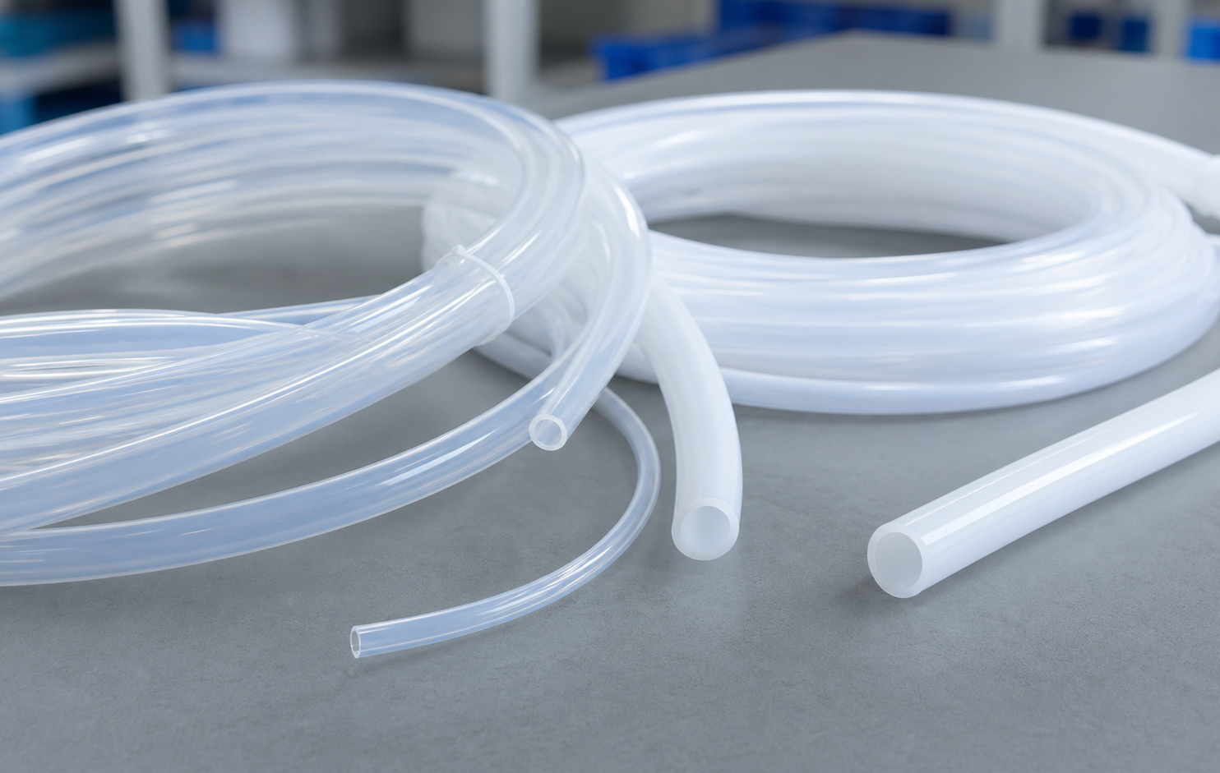
Flexible hose and custom-engineered connectors
Flexible hose and custom-engineered connectors
Path
What to send
Review result
Flexible hose
Routing geometry, bend radius, pressure, media, and connection method.
Flexible hose application review.
Custom-engineered connectors
Tube connection condition.
Custom connector review.
Send the RFQ through pure-flon.com/quote and include the checklist details above.
Pure-Flon Fluoropolymer Tubing Catalog - RFQ reference, 2026-06-04
8

Slide 9
RFQ checklist
RFQ checklist
Required input
Example detail
Application environment
Chemical media, operating temperature, pressure, and duty cycle.
Dimensional target
ID, OD, wall, tolerance, length, bend radius, and quantity.
Material signal
PTFE, PFA, FEP, hose, custom connector, or unclear; Pure-Flon can help shortlist.
Quality and handling
Clean handling, packaging, transparency, static control, or inspection requirement.
Commercial route
Country, target date, sample need, and preferred reply email.
Next step
Send the RFQ through pure-flon.com/quote and include the checklist details above.
Pure-Flon Fluoropolymer Tubing Catalog - RFQ reference, 2026-06-04
9

